Slide 1

Mini Project
Voting system

Slide 2

Problem Description
Millions of people have to wait in long ques to cast their vote during the elections which :
  Wastes people time
  Puts people at risk of catching the coronavirus
  Slows down the voting process

Slide 3
Blockchain Justification
The use of blockchain technology will guarantee
  The integrity of the election result since it difficult to alter a blockchain that is distrusted over a large peer to peer network
    Usually, a large number of people vote in election.
  This technology will improve the accuracy of the election results since the voting will keep track of the votes every time a vote is casted this will ensure
    The faster counting of votes

Slide 4
Records Structure
The record class (UML diagram shown in the next slide) has a Vote which stores the voter’s
  identity number (id)
  age
  political party they vote for (party).
Record store the index (i) of the record in blockchain, its time, current hash (curHash), previous hash (prevHash), data, vote and nonce.
The calcHash method calculates the hash of the record
The mine method uses the hash cash (with a difficulty of zero) algorithm which ensure that the hash of the record starts with a zero

Slide 5
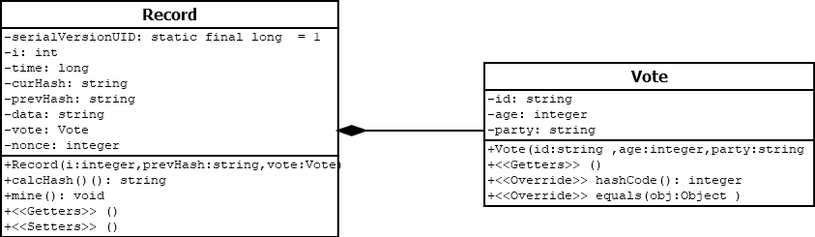
Records Structure: UML Diagram

Slide 6
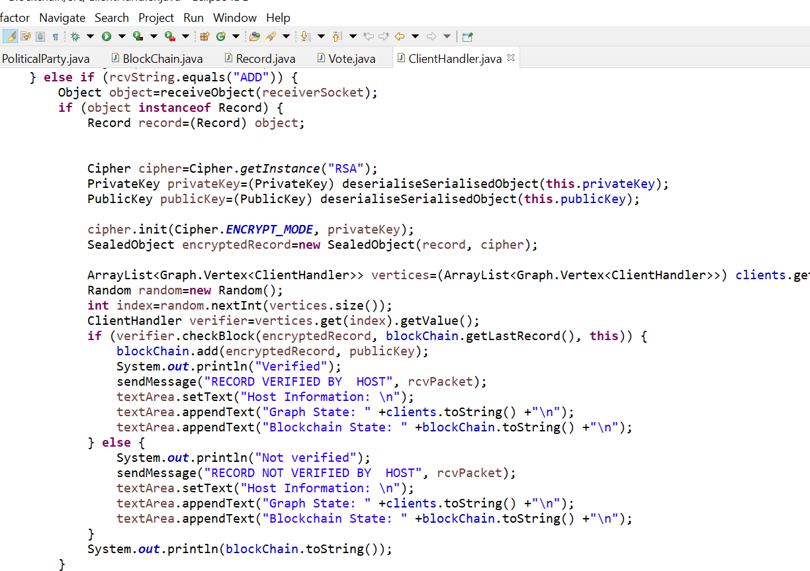
Proof of Stake
A proof of stake algorithm hash cash was used to verify the block before it is added to the blockchain.
  A random user on the network (stored in a graph) was chosen to verify the block with the assistance of the checkBlock method (showen in the next slide).

Slide 7
Data Communication Command Structure
A network protocol was design to facilitate the communication between a user and a host
  Host command structure
    The HI command is used to connect to a random user on the network
      The host responds by sending the HELO FROM HOST and a copy an instance of the recently connected client
    The ADD command is used to verify and add block to the blockchain
      The host responds by sending a copy an instance of the recently client that sent the block to be verified.
    The ADD PARTIES command is used to change the list of political parties running in the election

Slide 8
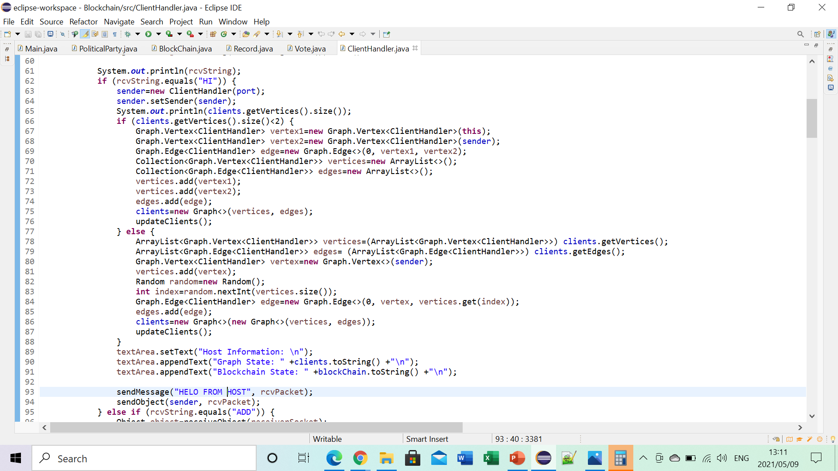
HI Command Code

Slide 9
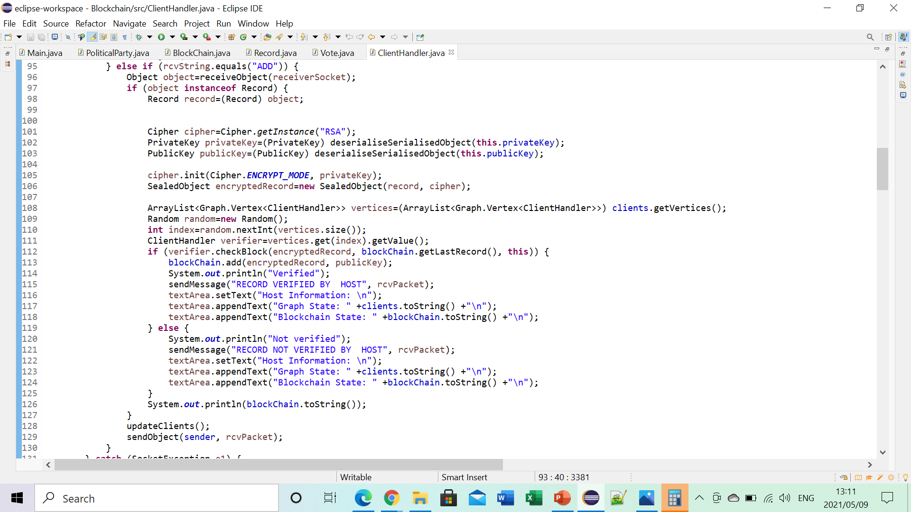
ADD Command Code

Slide 10
Bibliography
https://www.theguardian.com/us-news/2020/oct/15/early-voting-us-election-turnout-record

